Slide 1

Post-Quantum Cryptography
CSA1013 – Software Engineering
S Suvikumar
192424262

Slide 2
Introduction
Post-Quantum Cryptography (PQC) develops cryptography that remains secure against quantum attacks.
Quantum computers could break by used public-key systems such as RSA and ECC.
PQC algorithms are designed to run on conventional computers.
The goal is to protect data throughout the transition to quantum-safe security.
PQC is important for long-term confidentiality and digital trust.

Slide 3
PQC-Works
A key-generation process creates public and private keys using a quantum-resistant algorithm.
The public key can be shared openly for encryption or key establishment.
The private key is kept secret and is used for decryption.
Security on mathematical problems to resist both classical and quantum attacks.
PQC can be integrated into protocols such as TLS, VPNs, and secure storage

Slide 4
Problem Statement
traffic violations—such as signal jumping, speeding, and lane indiscipline—through video surveillance and image processing. Integrated with a robust database management system, the solution ensures efficient logging, storage, and retrieval of violation records, enabling automated fine generation, offender identification, and data-driven traffic regulation enforcement to enhance urban mobility and safety.
traffic violations—such as signal jumping, speeding, and lane indiscipline—through video surveillance and image processing. Integrated with a robust database management system, the solution ensures efficient logging, storage, and retrieval of violation records, enabling automated fine generation, offender identification, and data-driven traffic regulation enforcement to enhance urban mobility and safety.
traffic violations—such as signal jumping, speeding, and lane indiscipline—through video surveillance and image processing. Integrated with a robust database management system, the solution ensures efficient logging, storage, and retrieval of violation records, enabling automated fine generation, offender identification, and data-driven traffic regulation enforcement to enhance urban mobility and safety.
Quantum computers have the potential to break by used cryptographic algorithms such as RSA and ECC.
Current encryption methods may become insecure, putting sensitive data at risk.
There is a need for quantum-resistant algorithms that can protect information against both classical and quantum attacks.
Post-Quantum Cryptography (PQC) aims to develop and implement secure cryptographic techniques for a future quantum-safe digital environment.

Slide 5
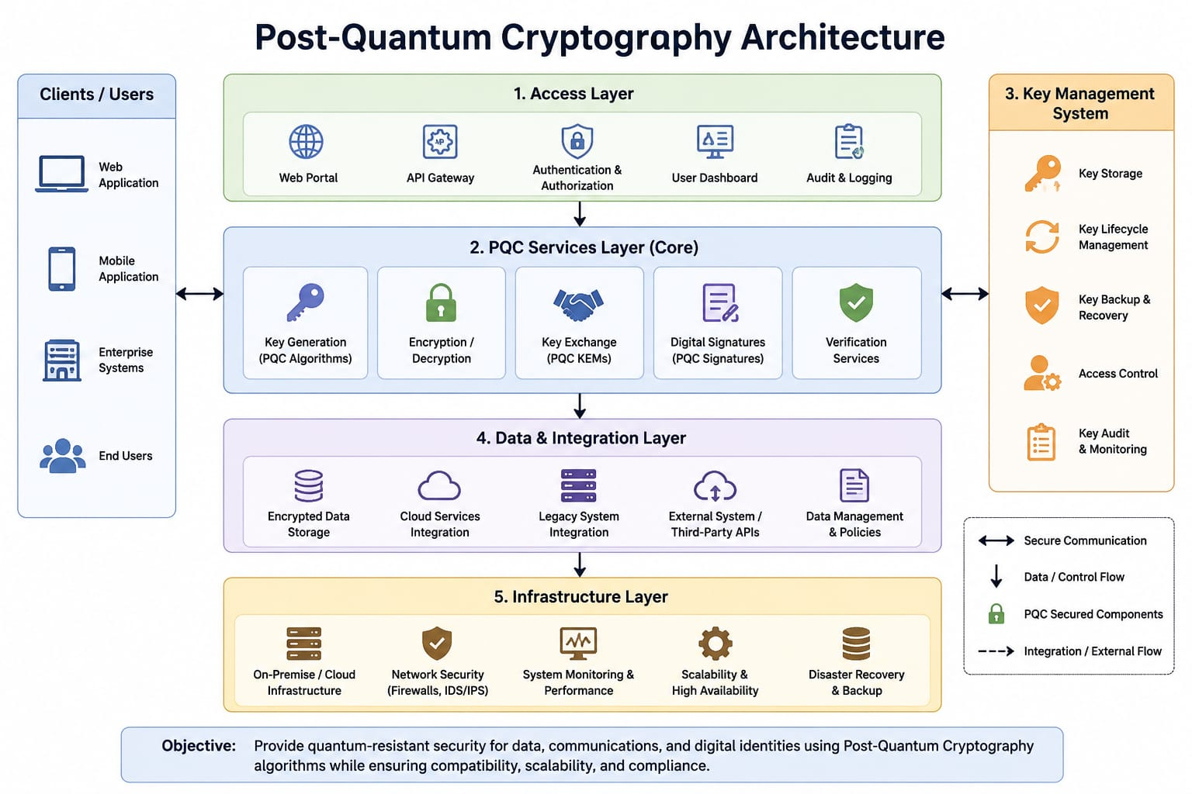
System Architecture:

Slide 6
ADVANTAGES AND CHALLENGES
Advantages:
protects against future quantum attacks.
Many PQC schemes can operate on existing classical computing infrastructure.
Challenges:
Some PQC keys and signatures are larger than traditional ones.
Migration requires testing, interoperability, performance analysis, and updated protocols.
Organizations must manage cryptographic agility and long-term security planning.

Slide 7
Applications of PQC:
Banking and Financial Services – Protects online banking, digital payments, and financial transactions from future quantum attacks
Government and Defense – Secures confidential government communications, classified information, and national security systems.
Cloud Computing – Protects sensitive data stored and transmitted through cloud platforms.
Healthcare Systems – Secures electronic health records and communication between hospitals and healthcare providers.
Internet and Communication – Provides quantum-resistant security for websites, emails, messaging apps, VPNs, and other digital communications.

Slide 8
Conclusion:
Post-Quantum Cryptography (PQC) provides security against potential attacks from powerful quantum computers.
It addresses the limitations of traditional algorithms such as RSA and ECC, which may be vulnerable to quantum attacks.
PQC helps protect sensitive data, digital communications, financial transactions, and government systems.
PQC is an important step toward building a secure, reliable, and quantum-ready digital future.

Slide 9


Slide 10
